Slide 1
Card Classification Using Deep Learning
Dual-Model Approach with
MobileNetV2 & DenseNet-201

Slide 2
🎓 Team Introduction
👤 Rohed Deb Ove
🆔 : 2104010202296
👤 Tamjidul Hasan
🆔 : 2104010202285

Slide 3
Introduction
🔍 Project Importance:
• Automated card recognition for gaming industry
• Accessibility tools for visually impaired players
• Casino automation and security systems
• AI-powered card game analysis
🎯 Real-world Applications:
• Mobile gaming applications
• Educational tools for card games
• Fraud detection in gambling establishments
• Digital card game assistants

Slide 4
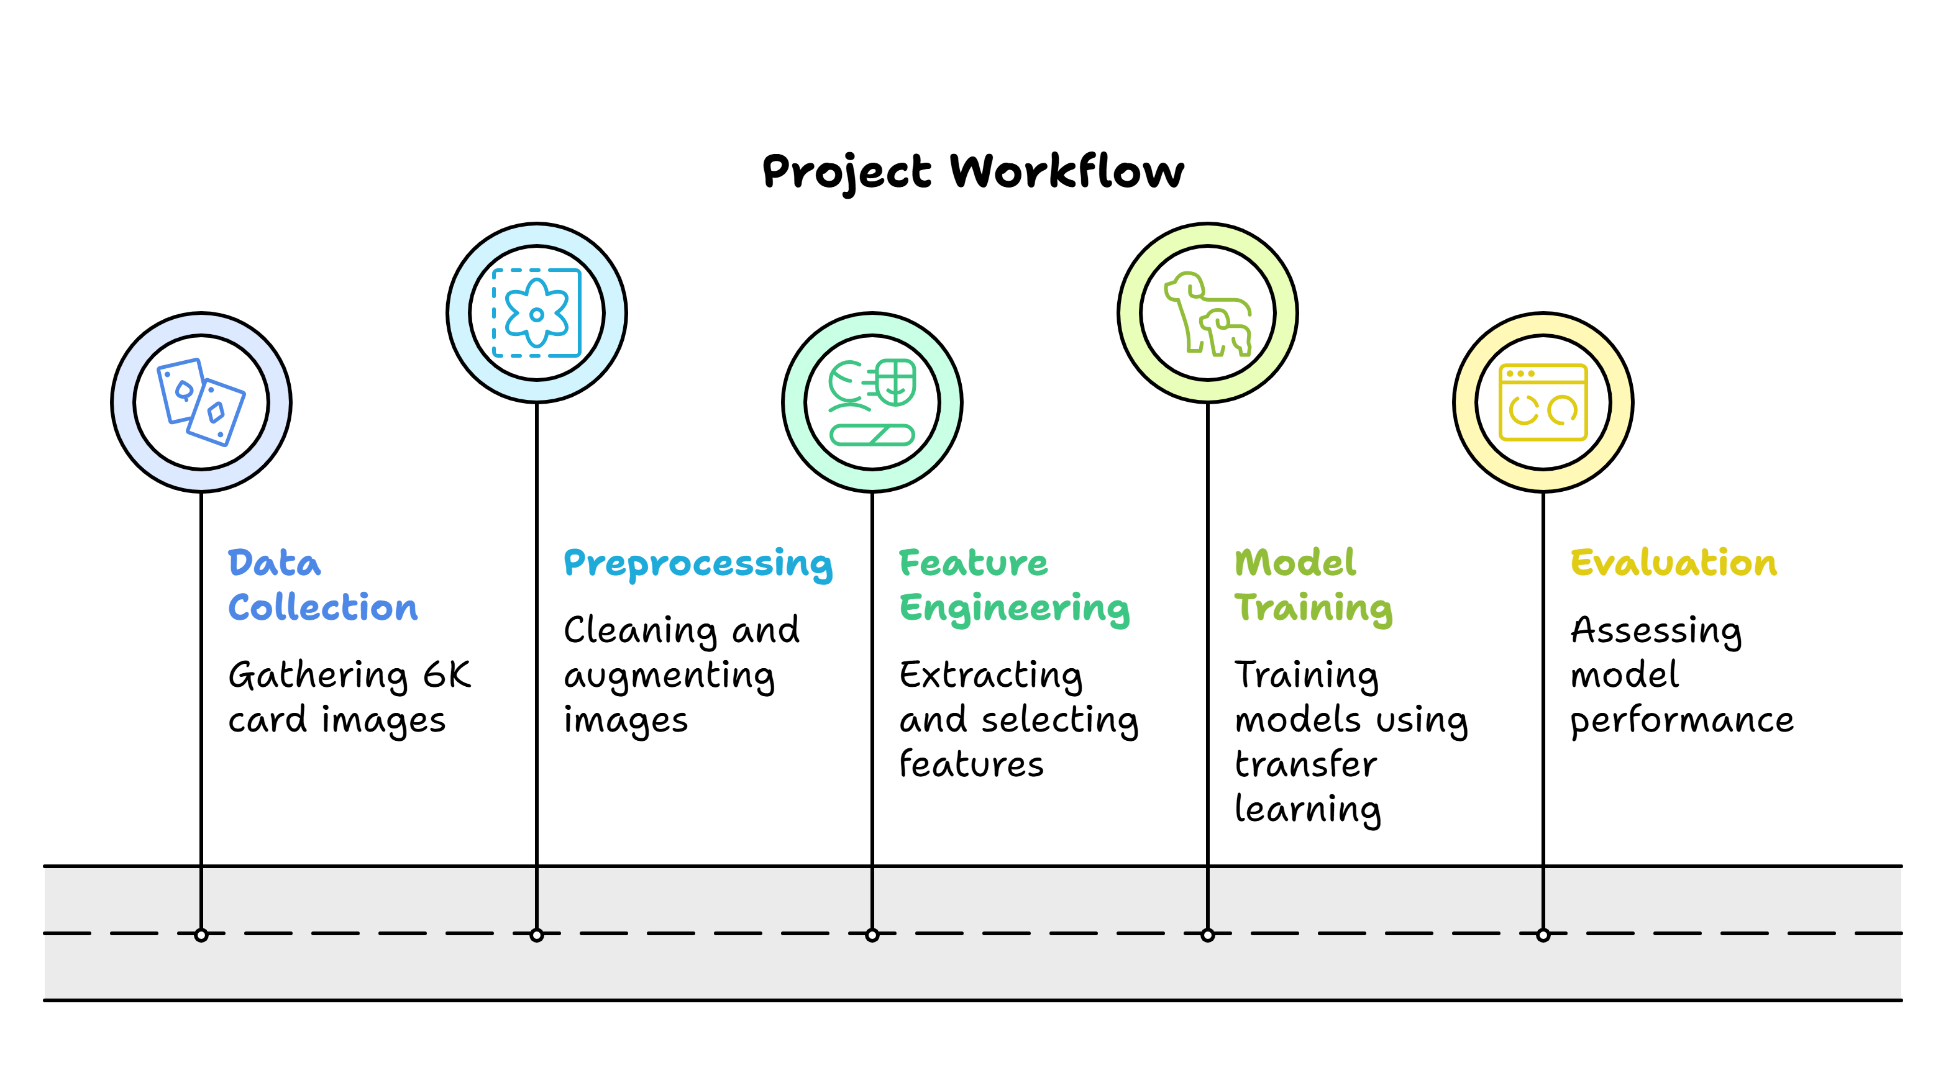
Project Workflow

Slide 5
Dataset Description
Cards Image Dataset
Dataset Statistics:
• Total Classes: 53 playing card categories
• Image Size: 224×224×3
• Data Split: Train (70%) / Validation (15%) / Test (15%)
Key Features:
• Balanced class distribution
• Multiple orientations and lighting
• Real-world card variations

Slide 6
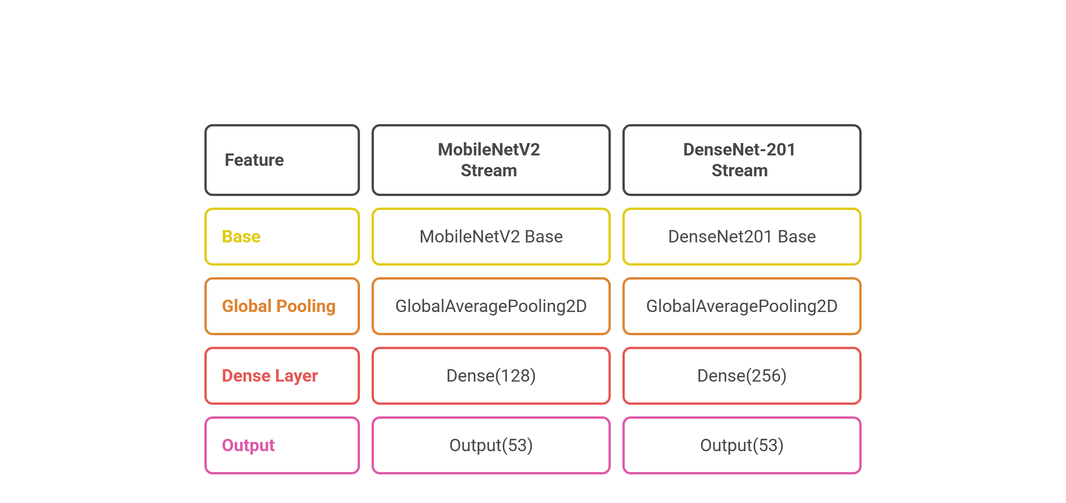
CNN Architecture Overview

Slide 7
Data Preprocessing Pipeline
🛠Comprehensive Preprocessing
Augmentation Techniques:
• Horizontal/Vertical flips
• Rotation (±20°)
• Zoom (80-120%)
• Brightness adjustment
Filter Applications:
• Median & Gaussian blur
• Edge detection (Canny)
• Sharpening filters
• Embossing effects

Slide 8
Hyperparameter Optimization
Parameters:
• Learning Rate: 1e-4
• Batch Size: 32
• Epochs: 20-25
• Dropout Rate: 0.5
Training Configuration:
• Optimizer: Adam
• Loss: Categorical Crossentropy
• Callbacks: EarlyStopping, ReduceLROnPlateau

Slide 9
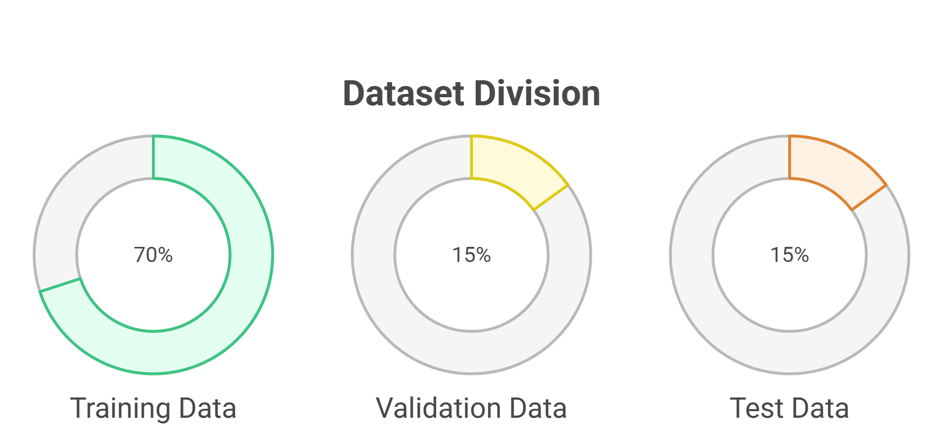
Data Segmentation Strategy

Slide 10
Model Training & Evaluation
🎯 Training & Evaluation Framework
Evaluation Metrics:
• Training/Validation Accuracy
• Training/Validation Loss
• Test Accuracy
• Confusion Matrix
• ROC Curves
Model Comparison:
• MobileNetV2 vs DenseNet-201
• Feature extraction capabilities
• Convergence behavior

Slide 11
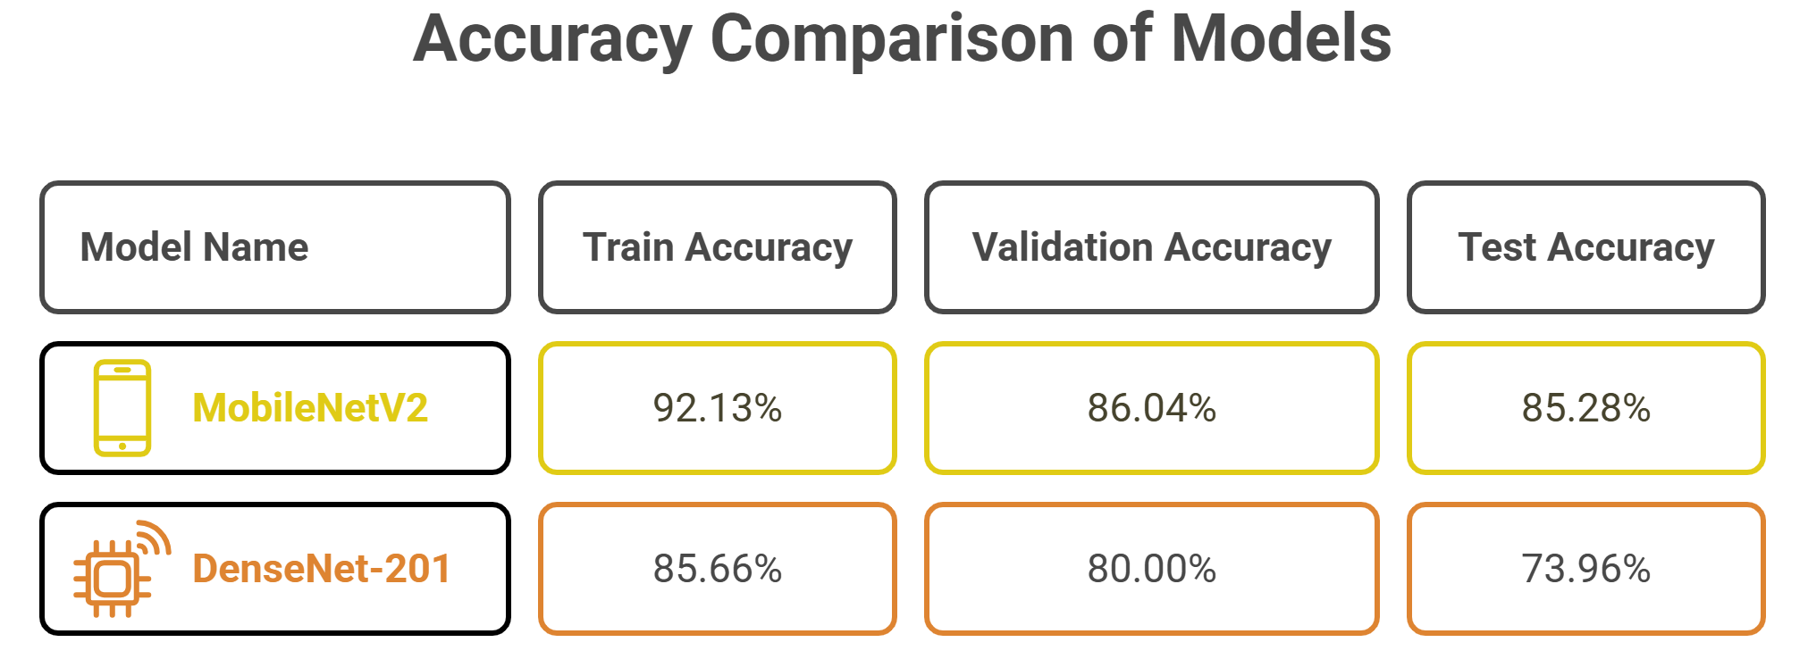
Results Analysis

Slide 12
Classification Results & Analysis
Model Predictions:
• Side-by-side model comparisons
• External image testing
Success Metrics:
• High precision across all card classes
• Consistent performance on test set
• Good generalization to unseen data

Slide 13
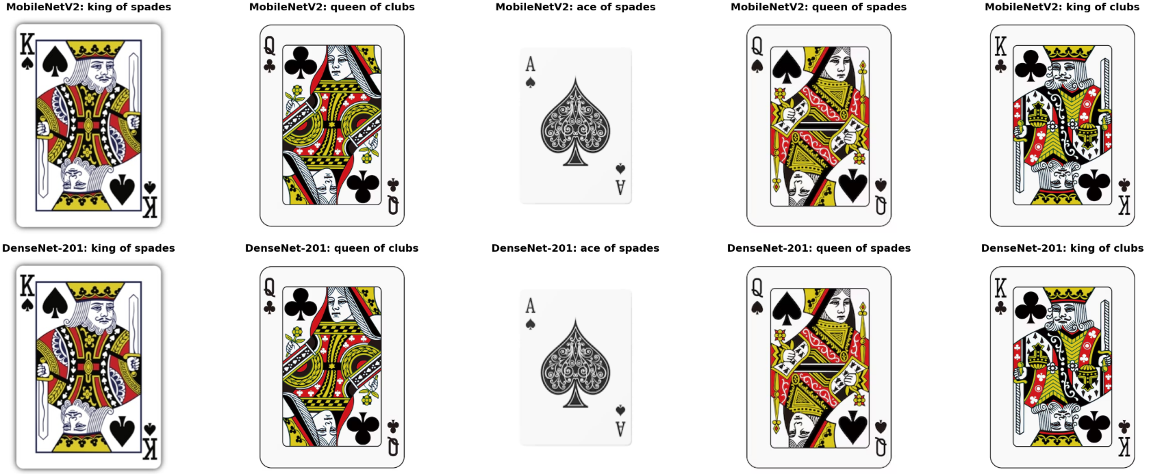
External Image Testing

Slide 14
Conclusion & Future Work
Project Achievements :
• Successful dual CNN architecture
• Comprehensive preprocessing pipeline
• Effective transfer learning
• High-accuracy card classification
Future Directions:
• Real-time video processing
• Mobile application development
• Multi-card hand recognition

Slide 15
Thank You!
We appreciate your attention and time.

